Slide 1

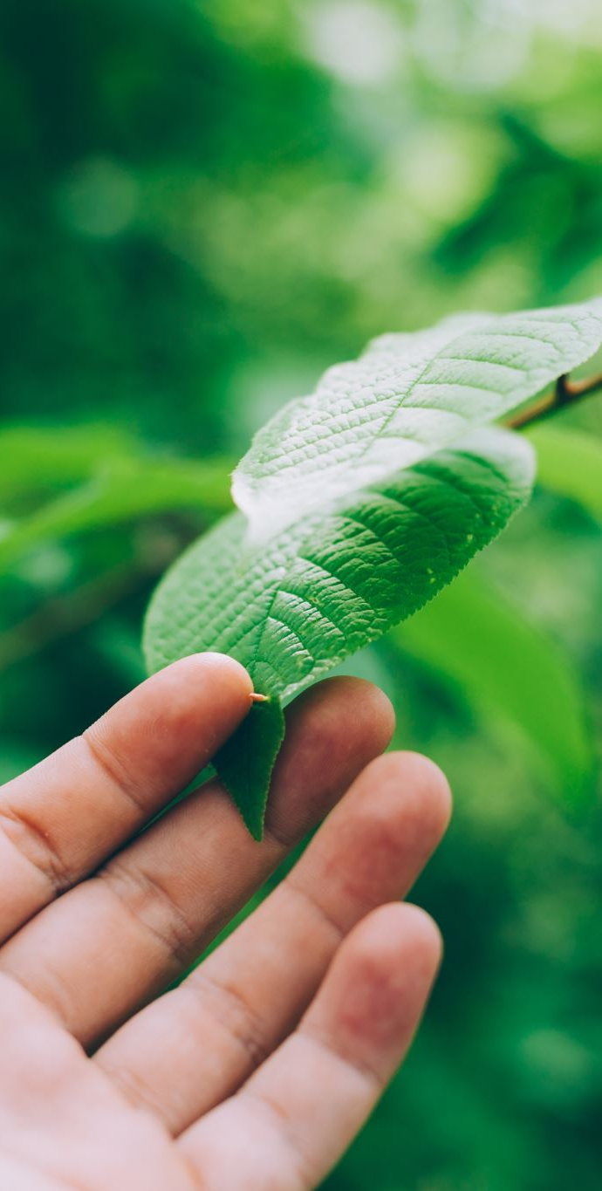
Depthwise separable convolution architectures for plant disease classification
By
Vishnuvivek Balya
Publishing Group:
Kamal KC, Zhendong Yin, Mingyang Wu, Zhilu Wu - ELSEVIER

Slide 2
Motivation
Agriculture is the backbone of the country. Farmers have a good selection of crops for his or her farm.
In developing countries, small farmers make up nearly 80% of the total production.
Due to external factors, the plants may get infected, and the crop will be lost resulting in a huge loss of production.
Most of the primary symptoms are microscopic, so human visual capabilities restrict the identification disease of.
This method could be more interesting, and time-intensive. There’s a need for a style system that mechanically acknowledges, classifies, and quantitatively detects disease symptoms.
Largely a variety of diseases are seen on the leaves of plants, fruits, or stems of the plant.
To avoid human interference, develop a computer vision system to find, recognize, and classify illnesses affecting crops
Automatic detection might prove gain in looking at huge fields of crops and leaf disease detection can automatically notice the diseases. Image processing plays a major role.

Slide 3
Problem statement
The journal points out the challenges in detecting plant diseases from leaf images in varied conditions.
The PlantVillage dataset used for this experiment consists of clean and cluttered background images.
Regular CNN models are effective but require high memory, computational resources & cost.
These constraints make them unsuitable for mobile or IoT devices.
The objective is to develop models using depthwise separable convolutions to reduce computational load.
The models must maintain high accuracy despite complex backgrounds and diverse conditions.

Slide 4
Objectives
To design efficient CNN models with lower memory and computational demands
Improve accuracy in detecting plant diseases from leaf images in diverse environments.
Create models optimized for use on mobile and IoT platforms with limited hardware.
Develop depthwise separable convolution architectures that balance model size, performance, and speed.
To compare these new models against the regular CNN architectures like MobileNet, VGG16, and AlexNet.

Slide 5
Contributions
Proposed depthwise separable convolution models, such as customized MobileNet variants, specifically designed for detecting plant diseases.
Compiled a new dataset of 6,580 plant leaf images for rigorous testing and evaluation of the models.
Showcased significant improvements in computational efficiency, memory usage, and classification accuracy.
Achieved high disease detection accuracy (up to 99.55%) using the developed models.
Conducted thorough comparisons with traditional CNN architectures like VGG16, and AlexNet, demonstrating the new models' advantages.

Slide 6
Results
The proposed models, especially the modified MobileNet, achieved an impressive accuracy of up to 99.55% in detecting plant diseases.
These architectures significantly reduced computational demands and memory usage, making them ideal for mobile and IoT applications.
When compared to traditional CNN models, the new designs demonstrated superior performance in both accuracy and efficiency, offering clear advantages for real-world use.
The models performed well on both full plant leaf images and segmented leaf images, showing robustness in different conditions.
The use of the modified adaptive centroid-based segmentation technique enhanced the models' ability to isolate relevant regions, further boosting accuracy.
The newly created plant leaf dataset allowed the models to handle multiple types of plant diseases across eight different plant species, proving their versatility and scalability.

Slide 7
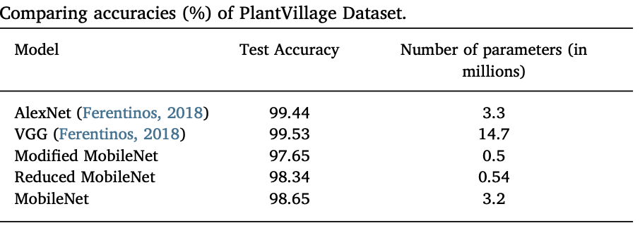
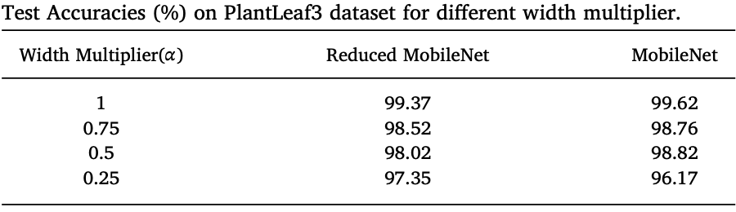

Slide 8
Critical Analysis
The use of depthwise separable convolutions reduces processing requirements, enabling compatibility with mobile and IoT devices. It effectively addresses a range of plant diseases across different species, showcasing its adaptability.
The complexity of deep learning models may impact their decision-making processes, making it harder for agricultural professionals to interpret results. The existing dataset of 6,580 images could benefit from increased size and diversity for better representativeness.

Slide 9
References
[1] Qiufeng Wu, Yiping Chen, Jun Meng, “DCGAN-Based Data Augmentation for Tomato leaf Disease Identification.” IEEE 2020.
[2] Jianyu Su, Meihua Wang, Zhenxin wu, Qingliang Chen, “Fast Plant Leaf Recognition using Improved Multiscale Triangle Representation and KNN for Optimization”, IEEE 2020.
[3] Bhumika S.Prajapati, Vipul K.Dabhi Harshadkumar, B.Prajapati, “A Survey on Detection and Classification of Cotton Leaf Diseases”, International Conference on Electrical, Electronics, and Optimization Techniques (ICEEOT) – 2016.
[4] Sachin D. Khirade, A.B Patil ,“Plant Disease Detection Using Image Processing”, International Conference on Computing Communication Control and Automation”, 2015.
[5] Malvika Ranjan, Manasi Rajiv Weginwar, NehaJoshi, Prof.A.B. Ingole, “Detection and classification of leaf disease using artificial neural network”, International Journal of Technical Research and Applications, 2015.

